Slide 1
Dr. SNS RAJALAKSHMI COLLEGE OF ARTS & SCIENCE (Autonomous)
Coimbatore -641049
Accredited by NAAC(Cycle–III) with ‘A+’ Grade
(Recognized by UGC, Approved by AICTE, New Delhi and
Affiliated to Bharathiar University, Coimbatore)
DEPARTMENT OF COMPUTER SCIENCE (GRAPHICS AND CREATIVE DESIGN)
COURSE NAME : AUDIO VIDEO EDITING TOOLS & TECHNOLOGY
II YEAR /III SEMESTER
Unit I- Editing Principles: Fiction and non-fiction

Slide 2
Editing Principles: Fiction and non-fiction
Fiction and nonfiction are two distinct categories of prose that serve different purposes and employ different narrative techniques.
Fiction refers to literature that is not grounded in real-life events but is made up or created from a writer’s imagination.
Nonfiction refers to factual stories based on real people, information, or events.
Notes:
In this presentation, we will explore the principles and processes of idea generation. We will discuss different techniques for generating ideas, as well as how to create an environment that is conducive to creativity. By the end of this presentation, you will be able to generate more and better ideas.

Slide 3
Goals of Editing
Improve clarity and coherence
Ensure consistency
Enhance flow and readability
Strengthen the writer's voice
Correct errors in grammar, punctuation, and spelling
Notes:
The goals of editing are the same for both fiction and non-fiction writing. Editors work to improve the clarity and coherence of the writing, ensuring the message is conveyed effectively. Consistency is essential in both genres, whether maintaining a consistent tone throughout a fictional narrative or ensuring factual accuracy in a non-fiction piece. Editing also focuses on enhancing the flow and readability of the writing, making it easy and enjoyable for the audience to consume. Additionally, editors help strengthen the writer's unique voice, allowing their personality and style to shine through. Finally, editing corrects any errors in grammar, punctuation, and spelling, ensuring a professional and polished final product.

Slide 4
Editing Fiction
Focus on plot, character development, and world-building
Ensure a strong narrative arc with a clear beginning, middle, and end
Create believable and relatable characters
Develop a vivid and immersive setting
Maintain a consistent tone and style
Notes:
When editing fiction, the focus lies on the core elements of storytelling: plot, character development, and world-building. Editors work with the author to ensure a strong narrative arc exists, with a clear beginning that hooks the reader, a compelling middle that builds suspense, and a satisfying end that resolves the story's central conflict. Creating believable and relatable characters is crucial in fiction, as readers need to connect with the characters to care about their journey. Editors also help develop a vivid and immersive setting, transporting the reader into the fictional world. Additionally, maintaining a consistent tone and style throughout the narrative is essential for establishing the overall mood and atmosphere of the story.

Slide 5
Editing Non-Fiction
Focus on accuracy, clarity, and objectivity
Fact-check all information to ensure its veracity
Organize content in a logical and easy-to-follow manner
Use clear and concise language
Support arguments with evidence and data
Notes:
Editing for non-fiction requires a rigorous approach to accuracy, clarity, and objectivity. Editors meticulously fact-check all information to ensure its veracity and source credibility. Organizing content in a logical and easy-to-follow manner is essential for guiding readers through the non-fiction text. Editors also ensure the language is clear, concise, and appropriate for the target audience. Additionally, when arguments are presented in non-fiction writing, they need to be supported with evidence and data to strengthen their validity.

Slide 6
Types of Editing
Developmental Editing: Focuses on the big-picture elements of the manuscript, such as plot, character development, and structure.
Copy Editing: Focuses on improving the clarity, conciseness, and flow of the writing. It also includes correcting errors in grammar, punctuation, and spelling.
Proofreading: The final stage of editing, focusing on catching any remaining typos, grammatical errors, or formatting inconsistencies.
Notes:
There are three main types of editing: developmental editing, copy editing, and proofreading. Developmental editing tackles the big-picture elements of the writing, providing feedback on plot, character development, and overall structure. Copy editing delves deeper into the language itself, focusing on improving clarity, conciseness, and flow. Additionally, copy editing involves correcting grammatical errors, punctuation mistakes, and spelling inconsistencies. Finally, proofreading is the final stage of editing, catching any remaining typos, grammatical errors, or formatting inconsistencies that may have slipped through the cracks.

Slide 7
Character Development - (Fiction)
Ensure characters are well-rounded and believable
Develop distinct personalities, motivations, and backstories
Show, don't tell: Use actions, dialogue, and internal monologue to reveal character traits
Create characters with flaws and vulnerabilities
Maintain character consistency throughout the story
Notes:
Developing well-rounded and believable characters is fundamental to successful fiction writing. Characters need to feel like real people with distinct personalities, motivations, and backstories that drive their actions. Editors help authors avoid simply "telling" the reader about a character's traits. Instead, editors encourage authors to "show" these traits through the character's actions, dialogue, and internal monologue. Characters should not be perfect; having flaws and vulnerabilities makes them more relatable and adds depth to the story. Finally, maintaining character consistency throughout the narrative ensures a believable and cohesive reading experience.

Slide 8
Dialogue - (Fiction)
Dialogue should sound natural and believable
Use dialogue to advance the plot, reveal character, and create emotional impact
Avoid exposition dumps: Dialogue should not solely be used to info-dump information
Vary sentence structure and word choice to add depth and realism
Use dialogue tags effectively to attribute speech
Notes:
Dialogue plays a crucial role in fiction, driving the plot forward, revealing character traits, and creating emotional connections with the reader. Editors ensure the dialogue is natural and believable, mimicking the way people actually speak. Effective dialogue serves multiple purposes: advancing the plot by conveying key information, revealing character motivations through their words, and creating emotional impact on the reader. Editors caution against exposition dumps, where characters simply explain things to each other and the reader. Dialogue should flow naturally and avoid sounding forced. Varying sentence structure and word choice adds depth and realism to the characters' voices. Additionally, editors ensure proper use of dialogue tags to attribute speech to the correct character.

Slide 9
Setting - (Fiction)
Create a vivid and immersive setting
Use sensory details to bring the setting to life
Ensure the setting is relevant to the story and contributes to the overall atmosphere
Consider how the setting influences the characters and plot
Be consistent with the details of the setting throughout the story
Notes:
A well-developed setting can transport the reader into the fictional world and enhance the narrative. Editors encourage authors to use vivid sensory details to bring the setting to life, allowing readers to visualize the environment through descriptions of sight, sound, smell, taste, and touch. The setting should not be an afterthought but an integral part of the story, contributing to the overall atmosphere, mood, and tone. Editors also consider how the setting influences the characters and plot. For instance, a dark and stormy night might create a sense of suspense or danger, while a bustling marketplace could introduce elements of conflict or opportunity. Finally, maintaining consistency with the details of the setting throughout the story ensures a cohesive reading experience.

Slide 10
Plot Structure - (Fiction)
Follow a clear and engaging plot structure, such as the three-act structure
Establish a central conflict early on
Raise the stakes and build suspense throughout the story
Provide a satisfying resolution that ties up loose ends
Ensure a logical progression of events with a cause-and-effect relationship
Notes:
A strong plot structure is the backbone of a compelling fictional narrative. Editors often recommend following a tried-and-true structure, such as the classic three-act structure, which features a clear beginning, middle, and end. The beginning introduces the characters, setting, and central conflict that drives the story. The middle section raises the stakes for the characters and builds suspense, keeping the reader engaged. Finally, the ending should provide a satisfying resolution that ties up loose ends and leaves the reader feeling fulfilled. Editors ensure a logical progression of events throughout the story, with a clear cause-and-effect relationship that makes the narrative feel believable.

Slide 11
Pacing and Tension - (Fiction)
Maintain a balanced pace that keeps the reader engaged
Alternate between moments of action and moments of reflection
Use pacing to build tension and suspense
Avoid information overload or dragging scenes
Vary sentence length and paragraph structure for a dynamic reading experience
Notes:
Pacing and tension are crucial elements for keeping the reader engaged in a fictional narrative. Editors help authors maintain a balanced pace that moves the story forward without feeling rushed or bogged down. Effective pacing often involves alternating between moments of action and suspense with moments of reflection or character development. This provides the reader with breathing room and allows them to connect with the characters on a deeper level. Editors also guide authors on using pacing strategically to build tension and suspense, keeping the reader guessing about what will happen next. Avoiding information overload and dragging scenes ensures the story remains engaging throughout. Finally, varying sentence length and paragraph structure adds dynamism to the writing and prevents it from feeling monotonous.

Slide 12
Point of View - (Fiction)
Choose a consistent point of view (POV) and stick with it
Common POVs include first-person (I), second-person (you), and third-person (limited or omniscient)
Each POV offers unique advantages and limitations
Consider how POV impacts the reader's experience and connection to the story
Ensure a consistent voice for the narrator in third-person POV
Notes:
Point of view (POV) determines whose perspective the story is told from. Editors help authors choose a consistent POV and stick with it throughout the narrative. Common POVs include first-person (the story is narrated by a character using "I"), second-person (a rare choice where the story directly addresses the reader using "you"), and third-person (the story is narrated from outside the characters using "he," "she," or "they"). Each POV offers unique advantages and limitations. First-person allows for a deep dive into the protagonist's thoughts and feelings but limits the scope of the story. Third-person limited offers a close connection to a specific character's perspective while third-person omniscient allows the narrator to access the thoughts and feelings of all characters. Editors consider how POV impacts the reader's experience and connection to the story. Additionally, when writing in third-person, it is crucial to maintain a consistent voice for the narrator.

Slide 13
Accuracy and Objectivity - (Non - Fiction)
Ensure all information is accurate and verifiable
Fact-check all sources meticulously
Avoid stating opinions as facts
Present a balanced and objective perspective, even on controversial topics
Clearly disclose any potential biases or conflicts of interest
Notes:
Point of view (POV) determines whose perspective the story is told from. Editors help authors choose a consistent POV and stick with it throughout the narrative. Common POVs include first-person (the story is narrated by a character using "I"), second-person (a rare choice where the story directly addresses the reader using "you"), and third-person (the story is narrated from outside the characters using "he," "she," or "they"). Each POV offers unique advantages and limitations. First-person allows for a deep dive into the protagonist's thoughts and feelings but limits the scope of the story. Third-person limited offers a close connection to a specific character's perspective while third-person omniscient allows the narrator to access the thoughts and feelings of all characters. Editors consider how POV impacts the reader's experience and connection to the story. Additionally, when writing in third-person, it is crucial to maintain a consistent voice for the narrator.

Slide 14
Accuracy and Objectivity - (Non - Fiction)
Ensure all information is accurate and verifiable
Fact-check all sources meticulously
Avoid stating opinions as facts
Present a balanced and objective perspective, even on controversial topics
Clearly disclose any potential biases or conflicts of interest
Notes:
Accuracy and objectivity are paramount in non-fiction writing. Editors work with authors to ensure all information presented is accurate and verifiable. This involves meticulous fact-checking of all sources, from scholarly articles to historical documents to online resources. Avoiding stating opinions as facts is crucial for maintaining credibility. Editors encourage non-fiction writers to present a balanced and objective perspective, even on controversial topics. This may involve presenting different sides of an issue fairly and allowing the reader to draw their own conclusions. Additionally, authors should be transparent about any potential biases or conflicts of interest that might influence their writing.

Slide 15
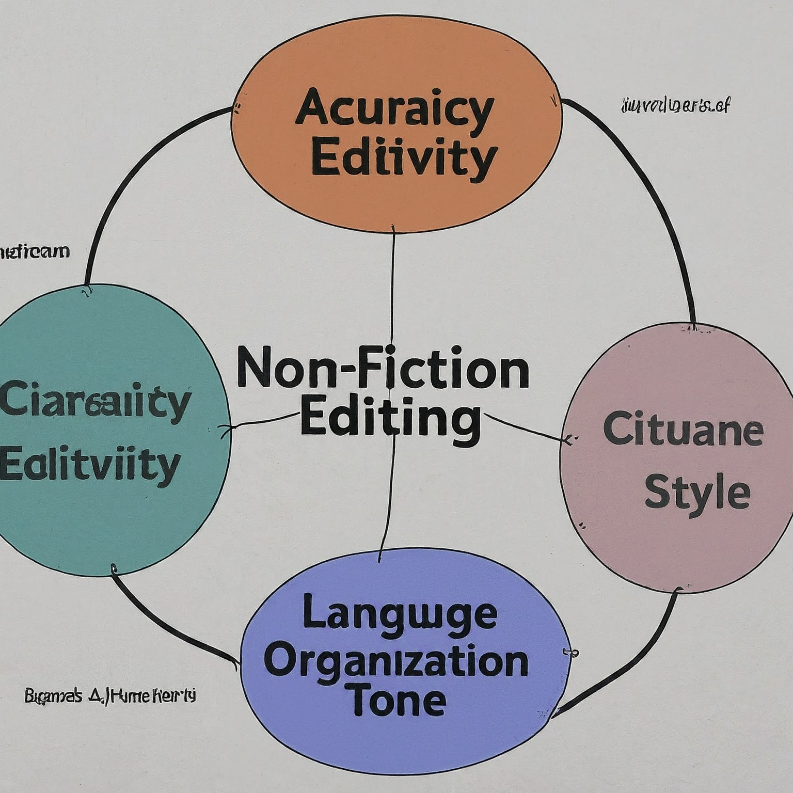
Clarity and Organization - (Non - Fiction)
Organize content in a logical and easy-to-follow manner
Use clear and concise language that is appropriate for the target audience
Employ headings, subheadings, and bullet points to improve readability
Guide the reader through the information in a logical progression
Ensure a smooth transition between ideas
Notes:
Clarity and organization are essential for effective communication in non-fiction writing. Editors collaborate with authors to ensure content is organized in a logical and easy-to-follow manner. This might involve structuring the writing with a clear introduction, body paragraphs, and conclusion. Using clear and concise language that is appropriate for the target audience is crucial. Editors also recommend employing headings, subheadings, and bullet points to improve readability and guide the reader's eye through the text.

Slide 16
Citation and Style - (Non - Fiction)
Use a consistent citation style guide, such as APA, MLA, or Chicago
Cite all sources properly to give credit to the original authors
Ensure citations are formatted correctly according to the chosen style guide
Include a reference list that provides complete information for all cited sources
Consider using in-text citations to guide readers to the reference list
Notes:
Proper citation and style are essential aspects of academic integrity and credibility in non-fiction writing. Editors assist authors by ensuring they use a consistent citation style guide, such as the widely used APA (American Psychological Association), MLA (Modern Language Association), or Chicago styles. Citing all sources properly gives credit to the original authors and allows readers to track down the source of information for further exploration. Editors ensure citations are formatted correctly according to the chosen style guide, following specific guidelines for punctuation, capitalization, and formatting. Additionally, including a reference list at the end of the non-fiction work provides complete information for all cited sources, allowing readers to easily locate the original material. Finally, in-text citations can be used throughout the writing to guide readers to the reference list for further details on specific points.

Slide 17
Language and Tone - (Non - Fiction)
Use clear, concise, and formal language appropriate for non-fiction writing
Avoid jargon or overly technical terms unless defining them clearly
Maintain a consistent tone throughout the writing
Consider the target audience and tailor the language and tone accordingly
Proofread for errors in grammar, punctuation, and spelling
Notes:
The language and tone used in non-fiction writing should be clear, concise, and formal. Editors help authors avoid jargon or overly technical terms that might confuse the reader. If technical terms are necessary, they should be clearly defined within the context of the writing. Maintaining a consistent tone throughout the non-fiction piece ensures a professional and polished feel. Editors also encourage authors to consider their target audience and tailor the language and tone accordingly. For instance, writing for a scholarly audience might require a more formal and technical tone, while writing for a general audience might benefit from a more accessible and conversational tone. Finally, thorough proofreading ensures the non-fiction writing is free from errors in grammar, punctuation, and spelling, maintaining a professional and error-free presentation.

Slide 18
Thank You

